Slide 1
Agenda
Architectural Patterns & Others
Architectural Patterns
  MVC
  MVVM
  N-Layer/N-Tier
  Onion/Clean Architecture
  SOA
  REST
  Microservices
  Modular Monolith Architecture
  Event-Driven Architecture
Domain-Driven Design Patterns
  Repository Pattern
  Unit of Work Pattern
  Service Pattern

Slide 2
Architectural Patterns
Help us to organize the components in the software architecture to make them maintainable and scalable.
The common architectural patterns are:
  MVC
  MVVM
  N-Layer/N-Tier
  Onion/Clean Architecture
  SOA
  REST
  Microservices
  Modular Monolith Architecture
Notes:
SOLID principles form the fundamental guidelines for building object-oriented applications.

Slide 3
Web Application Components and MVC Pattern
Data
Object
Model
Logic
Class
Controller
UI
DOM
View

Slide 4
MVC Pattern
Model
View
Controller
Eg. www.domain.com/Product/Edit/1

Slide 5
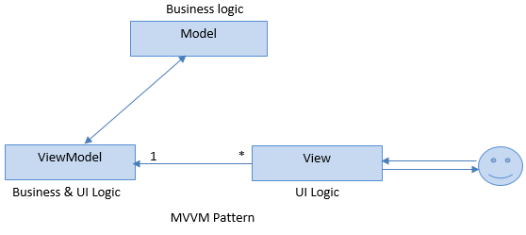
MVVM Pattern

Slide 6
MVVM Pattern
This pattern supports two-way data binding between the view and View model which enables automatic propagation of changes, within the state of view model to the View.
Model - The Model represents a set of classes that describes the business logic and data. It also defines business rules for data means how the data can be changed and manipulated.
View – The View represents the UI components like CSS, jQuery, HTML etc. It is only responsible for displaying the data that is received from the controller as the result. This also transforms the model(s) into UI.
View Model - The View Model is responsible for exposing methods, commands, and other properties that help to maintain the state of the view, manipulate the model as the result of actions on the view, and trigger events in the view itself.

Slide 7

N-Layer and N-Tier
Layer is logical separation of code.
Tier is a physical separation of code. In fact, tier is a machine, where the code/process runs.
DAL
(Class Library)
DAL
(WCF: Hosted App)
BAL
(Class Library)
BAL
(WebAPI: Hosted App)
PL
(MVC: Hosted App)
PL
(MVC: Hosted App)

Slide 8
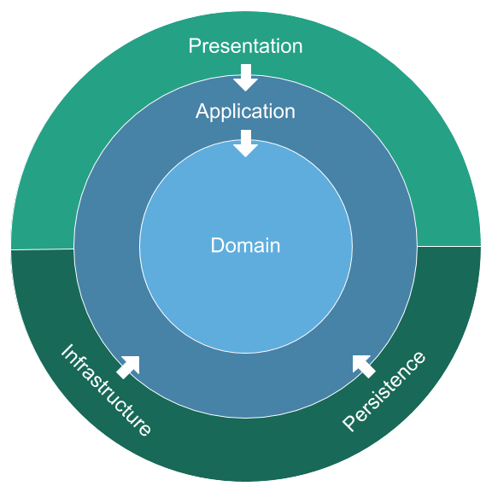

Onion Architecture => Clean Architecture
Notes:
Clean/Onion Architecture Both have the same common layers.
Clean Architecture is more general-purpose and works well for various domains.
Clean Architecture is use-case centric, emphasizing the orchestration of business rules through application services.
Onion Architecture is better suited for systems with a strong focus on Domain-Driven Design (DDD).
Onion Architecture is domain-centric, emphasizing the centrality of the domain model.
Both architectures can overlap, and it's not uncommon to see elements of both used together.
Clean Architecture is an extension or evolution of Onion Architecture

Slide 9
Clean Architecture
Focus on separation of concerns and the independence of business logic from external systems, frameworks, and infrastructure.
Helps to create flexible, maintainable, and testable systems by organizing code into layers with strict dependency rules.

Slide 10
Clean Architecture Components
Domain Layer (Core Logic):
  Entities/Objects
  Enums/Constants
Application Layer (Business Logic):
  DTOs, Mappers
  Repository Interfaces
  Application Services
  External Service/Providers Interfaces
Persistence Layer (Database Logic):
  Repository Implementation
  Cache
  DbContext
Infrastructure Layer (External Dependencies):
  Logging
  External Services/Providers like email, payment
Presentation Layer (UI):
  Controllers, View/UI
  ViewModels, UI Services
Notes:
Application Layer (Orchestrator): The UserService in the Application Layer orchestrates the user registration process but does not implement any core business rules.
Domain Layer (Business Logic): The User entity contains the actual business logic (e.g., email validation, password hashing), ensuring that the business rules are isolated and protected from changes in the application or infrastructure.
Infrastructure Layer (Persistence): The Infrastructure Layer contains the repository implementations and database access logic (using DbContext in this case).

Slide 11
Data Flow
Presentation Layer → Application Layer → Domain Layer
Persistance Layer → Application Layer
Persistance Layer → DB Dependencies
Infrastructure Layer → Application Layer
Infrastructure Layer → External Dependencies
Notes:
The Domain Layer remains independent of external concerns (like databases or services).
The Application Layer orchestrates business operations but relies on both the Domain Layer for business rules and the Infrastructure Layer for external interactions.
The Infrastructure Layer implements the technical details required for persistence or external communication, but it is decoupled from the core domain logic.
The Presentation Layer should not directly access the Infrastructure Layer.
It should go through the Application Layer, which abstracts the infrastructure details through interfaces.
This ensures a clean separation of concerns, better maintainability, and adherence to Clean Architecture principles.

Slide 12
Clean Architecture vs. N-Tier Architecture
Aspect | Clean Architecture | N-Tier Architecture
Focus | Decoupling business logic from frameworks and infrastructure. | Logical separation of UI, logic, and data.
Dependency Flow | Always inward. Outer layers depend on inner layers. | Layers may have bidirectional dependencies.
Core Principles | Dependency inversion, separation of concerns, testability. | Physical separation, modularity.
Testability | Highly testable due to dependency isolation. | Can be less testable if layers are tightly coupled.
Technology Agnostic | Core logic is independent of frameworks or databases. | Often tied to specific technologies (e.g., ORM, database).
Adaptability | Easier to switch frameworks, databases, or UI components. | Requires significant effort to make major changes.
Layer Names | Domain, Application, Infrastructure, Presentation. | Presentation, Business Logic, Data.
Purpose | Protect core business logic from external changes. | Organize an application into tiers for separation.

Slide 13
SOA (Service Oriented Architecture)
An architectural design pattern which states that every component of a system should be a service.
System should be composed of several loosely-coupled services means services should be independent.
The changes into one of the service should not affect any other services.
WSDL, UDDI, and SOAP are the fundamental pieces of the SOA infrastructure.
Notes:
A resource is any information that has name (like image, document etc.) and an address represented by a URI.

Slide 14
REST (REpresentational State Transfer) Architecture
REST is based upon the following 5 principles:
  Addressable Resources - Each resource should be identified by a URI.
  Simple and Uniform Interfaces - Keep your interfaces simple and uniform. This can be achieved by using the HTTP/HTTPS protocol uniform methods.
  Representation Oriented - Representation of resources are exchanged. Representation may be in many formats like XML, JSON etc.
  Communicate Stateless - Any session-specific data should be held and maintained by the client and transferred to the server with each request.
  Cacheable - Clients should be able to cache the responses for further use.
Notes:
A resource is any information that has name (like image, document etc.) and an address represented by a URI.

Slide 15
SOA vs. REST
Aspect | REST | SOA
Design Focus | Resource-based, stateless communication | Service-based, supports both stateful and stateless
Communication | HTTP/HTTPS using standard methods (GET, POST, PUT, DELETE) | Protocols like SOAP, MSMQ, AMQP and TCP/IP
Scalability | High, due to statelessness and caching | Moderate, can be complex due to state management
Interoperability | Web-based, easy to integrate over the web | High, supports integration of heterogeneous systems
Performance | Lightweight, typically faster due to less overhead | Can be slower due to protocol overhead (e.g., SOAP)
Complexity | Simpler, especially for web-based applications | More complex, suited for enterprise-level integration
Use Cases | Web applications, mobile applications, APIs | Enterprise applications, legacy system integration
State Management | Stateless | Can be stateful or stateless
Service Reusability | Moderate, primarily resource-focused | High, promotes reuse of business services
Standardization | HTTP methods, uniform resource interface | Service contracts, WS-* standards

Slide 16
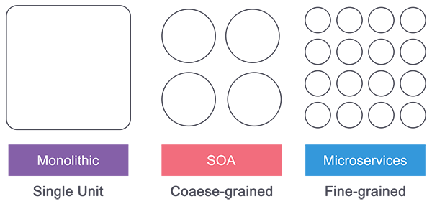
Monolithic vs. N-Layer vs. SOA vs. Microservices
Monolithic: Single Unit
Multi Units: N-Layer/SOA
Smaller Units: Microservices
Notes:
The main point to SOA (as compared to standard N-Tier architecture) is re-usability of the underlying services. This is where the aforementioned loose coupling comes in very handy - your web services are generic enough and independent enough to be used in many different applications.

Slide 17
Microservices Patterns
A Microservice is a small unit that has only one responsibility or single logic which solve a specific problem.
Microservices are small & independent services that work together to build highly automated, independent and evolving software.
Each Microservice can be deployed independently.
All services don't need to share the same technology stack, libraries, or frameworks.
Notes:
Service Oriented – Services communicate with each other over the network
Loosely coupled elements – You can update the service independently and updating one service doesn’t require changing in any other service
Bounded Context – Self Contained; you can update the code without knowing anything about the internals of other microservices

Slide 18
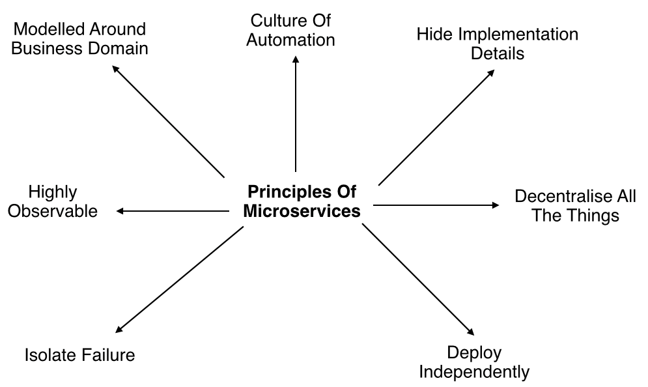
Microservices Principles

Slide 19
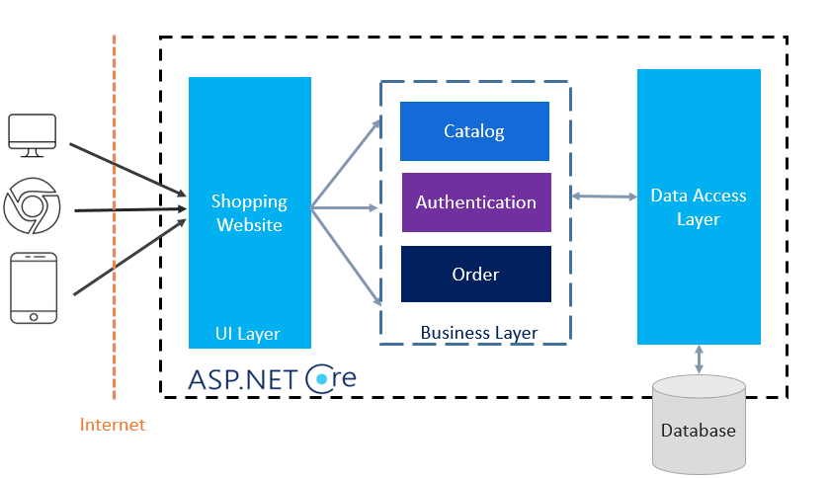
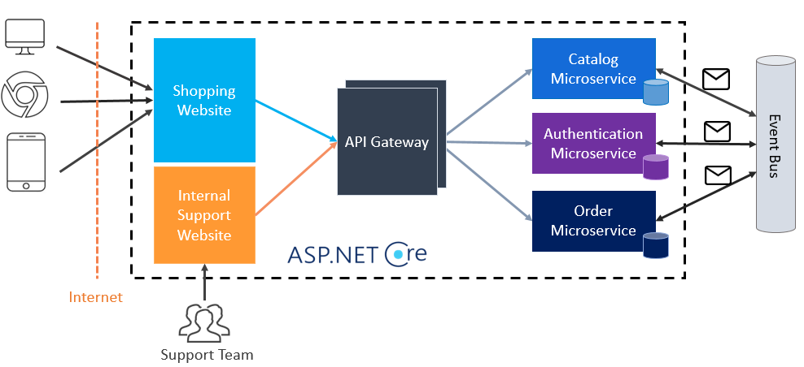
N-Layer App to Microservices

Slide 20
Modular Monolith Architecture
A software design approach that combines the simplicity of a monolithic architecture with the modularity and flexibility with microservices.
Modular Monolith Architecture
Single Deployment Unit
Modular Design
Separation of Concerns
Ease of Development and Testing
Performance and Scalability
Transition Path to Microservices
Notes:
Single Deployment Unit:
The application is packaged and deployed as a single unit, simplifying deployment and avoiding the complexities of managing multiple services.
Modular Design:
The application is divided into distinct modules, each responsible for a specific business capability or function. Modules communicate through well-defined interfaces or APIs, ensuring loose coupling and high cohesion.
Separation of Concerns:
Each module encapsulates its own logic, data, and dependencies, making the system easier to understand, develop, and maintain. This allows teams to work on different modules simultaneously without affecting others.
Ease of Development and Testing:
Developers can focus on individual modules, making the codebase more manageable. Testing is simplified, as each module can be tested independently before integration into the larger system.
Performance and Scalability:
Individual modules can be optimized for performance. However, horizontal scalability is limited compared to microservices architecture, where each service can be scaled independently.
Transition Path to Microservices:
A modular monolith can serve as a stepping stone to a microservices architecture. As the need for scalability and independent deployment grows, individual modules can be extracted and deployed as microservices.
==========
Modular Database Design:
Schema per Module: Each module has its own schema within the same database. This helps in maintaining the separation of concerns and ensures that the modules are loosely coupled.
Table Ownership: Each table in the database is owned by a specific module. Only the owning module can directly modify its tables, while other modules can interact with the data through well-defined interfaces or APIs.
Transaction Management:
Single Database Transaction: Since it’s a monolithic deployment, database transactions can span multiple modules if necessary, ensuring data consistency.
Unit of Work Pattern: Implementing the Unit of Work pattern can help manage transactions across multiple modules, ensuring that a series of operations either all succeed or fail together.
Shared Database Concerns:
Common Tables: Some tables, like user management or logging, might be shared across modules. Ensure these are well-documented and managed centrally to avoid conflicts.
Example: Consider an e-commerce application with modules for user management, product catalog, and order processing. Each module has its own schema within a single database:
User Module: Handles user-related tables like Users, UserRoles, etc.
Product Module: Manages Products, Categories, etc.
Order Module: Contains Orders, OrderItems, etc.

Slide 21
Use Cases for Modular Monolith Architecture
Small to Medium-sized Applications: Ideal for applications where the complexity of managing microservices is not justified.
Incremental Development: Suitable for teams planning to transition to microservices in the future but want to start with a simpler approach.
Rapid Prototyping: Useful for quickly developing and iterating on new applications while maintaining a clean, modular structure.

Slide 22
Event-Driven Architecture (EDA)
A software design style where the flow of the program is determined by events such as user actions, sensor outputs, or messages from other programs or processes.
  Event: Represents a significant change in state or the occurrence of an action. Events are central to EDA and drive the system’s behavior.
  Producer: A component that generate events.
  Consumer: A component that react to events.
  Channels: Events are transmitted via channels (queues or topics) which decouple producers from consumers.
  Store: An event store is a database, used for auditing, replaying events, and sourcing state changes.
Producer
Consumer
Channel/Bus
Store (Optional)
Event
Notes:
Events: An event represents a significant change in state or the occurrence of an action. Events are central to EDA and drive the system’s behavior.
Producers: Producers are components that generate events.
Consumers: Consumers are components that react to events.
Event Channels: Events are transmitted via channels (queues or topics) which decouple producers from consumers, allowing them to operate independently and scale individually.
Event Store: An event store is a database optimized for storing and retrieving events. It can be used for auditing, replaying events, and sourcing state changes.

Slide 23
Event-Driven Architecture vs. Microservices
Aspect | Event-Driven Architecture | Microservices Architecture
Design Focus | Asynchronous, event-driven interactions | Independent, self-contained services
Communication | Asynchronous messaging (events) | Synchronous using REST APIs, Asynchronous using events
Decoupling | High decoupling due to asynchronous nature | Moderate decoupling; services are independent but may rely on synchronous calls
Scalability | Easy to scale consumers independently based on event load | Each service can be scaled independently
Complexity | Can be complex due to event choreography and orchestration | Complexity in managing service dependencies and communication
Use Cases | Real-time processing, IoT, reactive systems | Business applications with distinct domain services
Data Management | Event sourcing and eventual consistency | Strong consistency within service boundaries
Fault Tolerance | Resilient to individual component failures | Service resilience through isolation and redundancy

Slide 24
Event-Driven vs. Message Based Communication
All events are messages, but not all messages are events.
Event-driven = notify others that something happened.
Message-based = instruct, ask, or inform through messages (might be an event)
Feature | Event-Driven | Message-Based
Communication Style | Fire-and-forget (event notification) | Request/command/response
Intent | Notify that something happened | Tell or ask another service to act
Direction | One-way | Often two-way (request-response)
Coupling | Low (producer doesn’t know consumer) | Medium (sender often expects action)
Examples | Kafka, Event Grid | RabbitMQ, MSMQ, Azure Service Bus
Message Types | Event | Event, Command, Query

Slide 25
Event-Driven Architecture and Microservices
Event-Driven Microservices: Microservices can leverage EDA for communication, improving decoupling and resilience. Events can notify other services of state changes or trigger actions asynchronously.
Hybrid Approaches: Combining synchronous and asynchronous communication where appropriate can provide the benefits of both architectures.

Slide 26
Domain-Driven Design Patterns

Slide 27
Domain Driven Design
Refers to the application’s problem space as the domains and subdomains. Identifying the business capabilities and its organizational structure and identifying the different areas of expertise.
A domain consists of multiple subdomains. Each subdomain corresponds to a different part of the business. Subdomains can be classified using the following criteria:
  Core: Most important and key differentiator of an application.
  Support: Business-related and used to support business activities.
  Generic: Not specific to business but is used to enhance business operations.

Slide 28
Domain Driven Design Example
For example, the subdomains of an online food delivery domain application include:
  Authentication Management
  Item Management
  Order Management
  Delivery Management

Slide 29
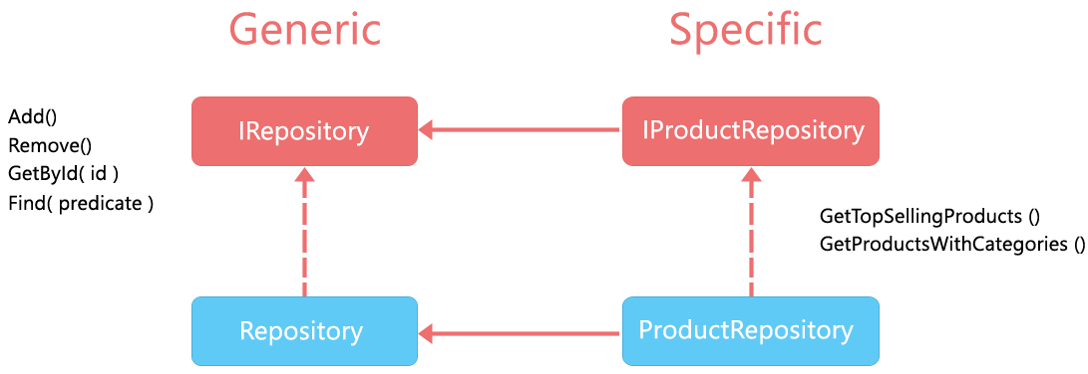
Repository Design Pattern
Mediates between the domain and data mapping layers, acting like an in-memory collection of domain objects.
Acts as an abstraction between the application and data source

Slide 30
Advantages of Repository Design Pattern
Minimize duplicate query logic
Supports SOC since application need not to know about data sources and it’s access logic
Decouples the application from persistence framework like EF, Dapper, Nhibernate etc.
Allows unit testing since repositories are bound to interfaces which can be injected into classes at run time

Slide 31
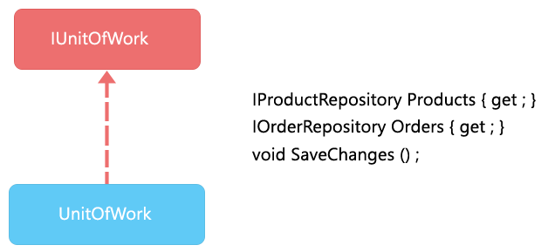
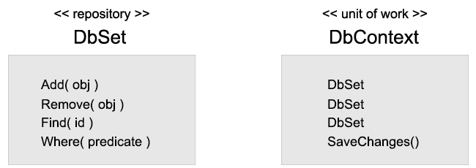
Unit of Work Pattern
Maintains a list of objects affected by a business transaction and coordinates the writing out of changes - By Martin Fowler
Helps to manage transactions across multiple repositories, ensuring that a series of operations either all succeed or fail together.

Slide 32
Service Pattern
Used to encapsulate business logic or application logic.
Make Logic to reusable across different parts of the application.
Promotes separation of concerns and make application to be more modular, maintainable, and testable.

Slide 33
Service Pattern vs. Repository Pattern
Service Pattern: Focuses on encapsulating business logic, workflows, and processes. It coordinates operations across multiple entities and repositories.
Repository Pattern: Focuses on data access logic, providing a consistent interface for CRUD operations and abstracting the data storage mechanism.
These two patterns often work together where Services use repositories to access and manipulate data, ensuring that business logic is decoupled from data access logic.

